Slide 1
Assignment 1
Cleaner
Comp-4770
Krish Patel

Slide 2
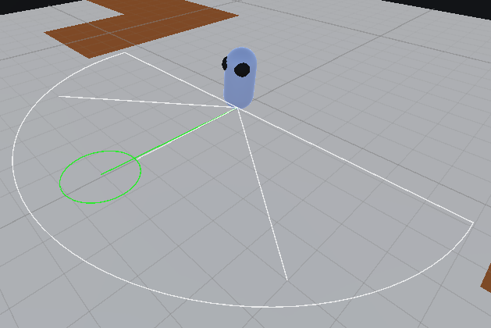
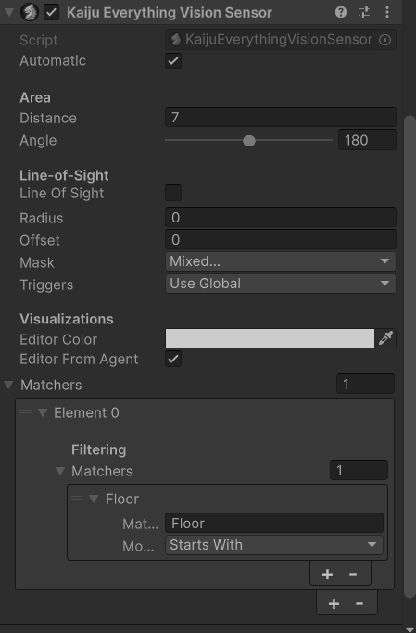
Sensor
Used an “Everything vision sensor”
Filters for all floors
  Agent checks if the floor is dirty or not

Slide 3
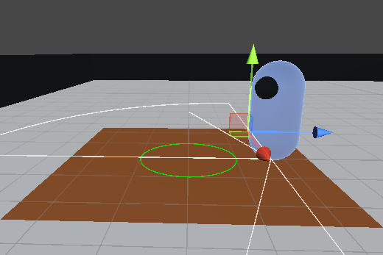
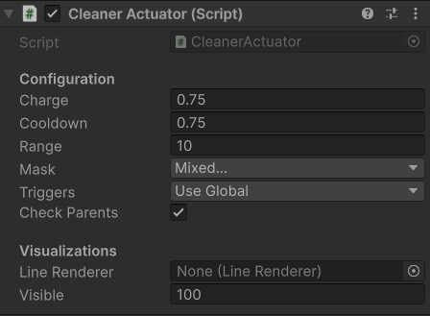
Actuator
Actuator inherits the Kaiju Attack Actuator
Actuator is placed in front of the agent and turned 45 degrees
Takes ¾ of a second to clean
Also has ¾ second cooldown

Slide 4
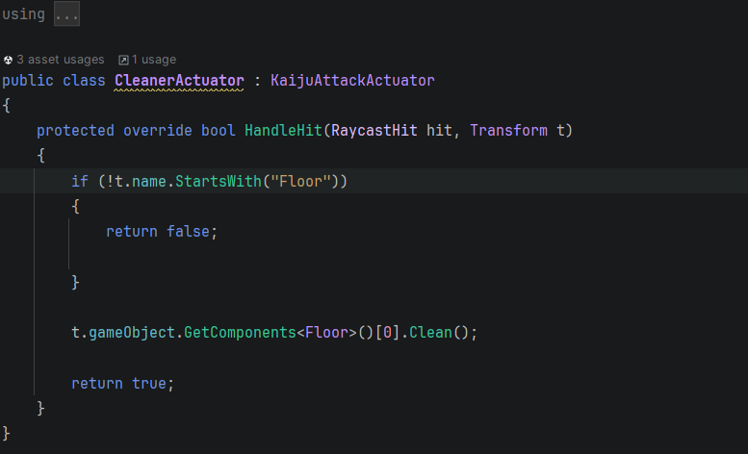
Actuator Code

Slide 5
Cleaner Agent
Basic FSM
Look for closest point on path
Roomba
Sensor Found Dirty Floor
Floor cleaned or failed to clean
Clean Floor
Move to Dirty Floor

Slide 6
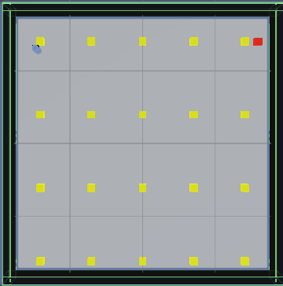
What is Roomba
Agent follows the follow points like a Roomba
Red cube to avoid edge case

Slide 7
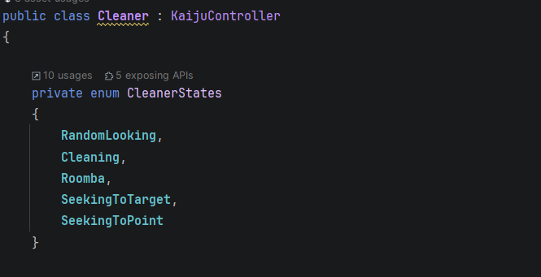
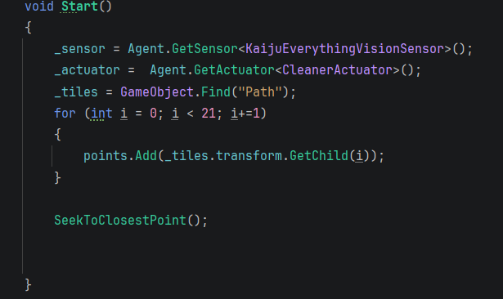
Cleaner Agent
Cleaner inherits Kaijicontroller class
Get all the points for the path following
Setup sensors and actuators
Enter the FSM

Slide 8
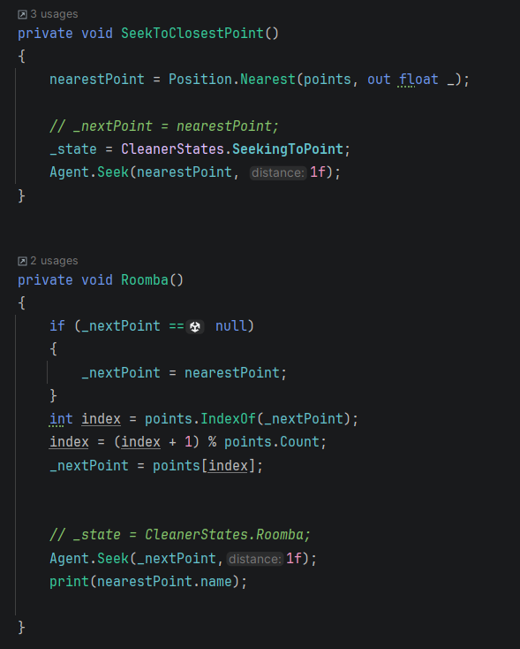
Seeking/Roomba
Seek to closest finds the closest point to the agent
Roomba will go to the next point in the list and seeks to it

Slide 9
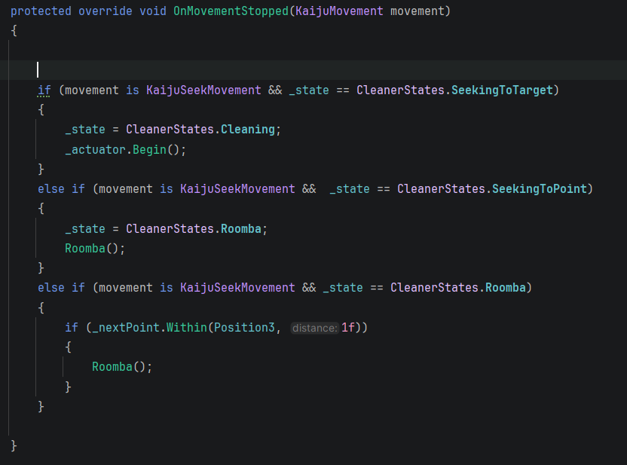
OnMovementStopped
Agent Stops and cleans once its reached the tile (Enter cleaning state)
Once the agent has seeked to a point it enters the Roomba state (Enter Roomba)
If we are already roombaing we continue to Roomba

Slide 10
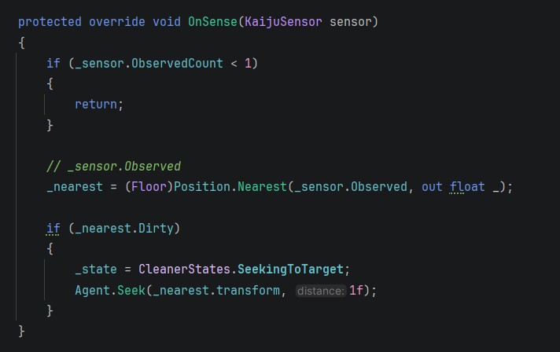
OnSense
Break out of the current state to go to seek to the closest tile
Once there onMovementStopped takes over

Slide 11
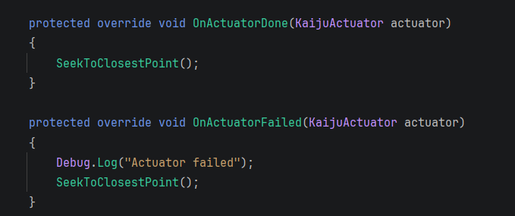
Actuator
Once done cleaning (or failed) it makes its way back to roombaing by seeking the closest point first

Slide 12
Questions?
I probably forgot to talk about something

